Slide 1

Covid-19 patient monitoring
Member of the group:
Chiara Morgillo
Erika del Rosso
Professors:
OSMANI Aomar
HAMIDI Massinissa

Slide 2
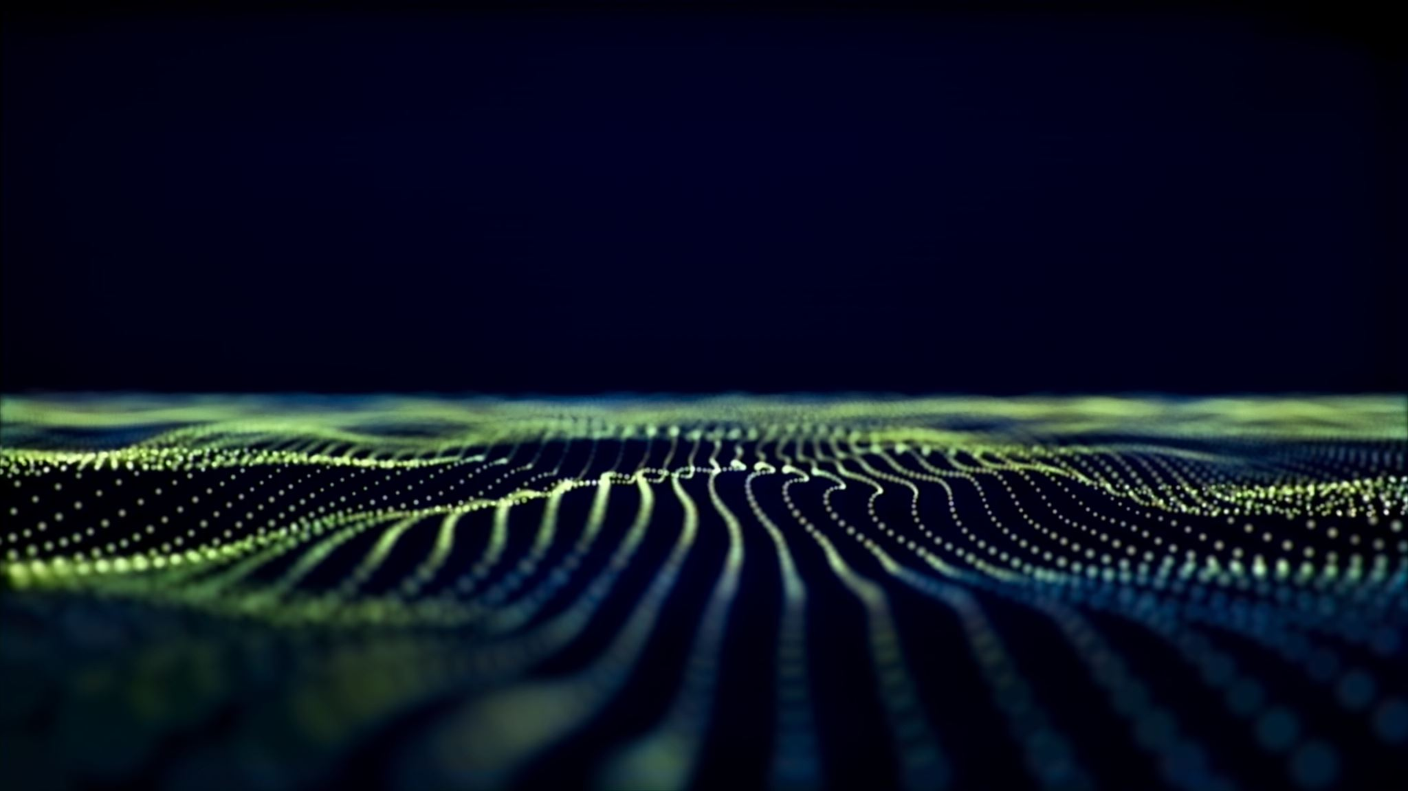
Summary
Introduction: The problem
Our solution
State of the art
Implementation
Code
Problems
Conclusion

Slide 3
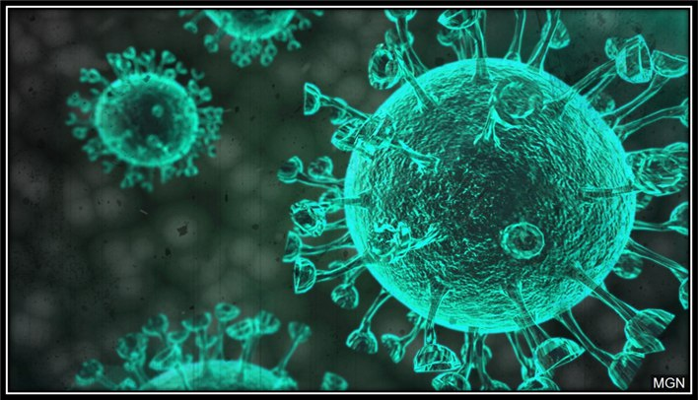
Introduction: The problem
The Covid 19 virus is a big problem in this period of health crisis, this has led to several changes in the daily lives of all of us. One of the biggest problems is related to the monitoring of patients from home, who tested positive for coronavirus, but asymptomatic, or those at risk of contagion, such as the elderly. There are multiple solutions, but most involve a waste of time and personnel, which not all hospitals can cope with.
While on a personal level they involve the use of multiple medical devices, sometimes expensive or unavailable given the high frequency of demand on the market.

Slide 4

Our solution
There are numerous solutions to these problems. Our consists in the creation of a single device capable of monitoring some symptoms from home that may represent the onset of the virus in the patient considered. This is possible thanks to the measurement of three vital signs:
·Heart rate of the patient;
·Blood oxygen level of the patient;
·Body temperature of the patient.
The doctor treating the patient in question will therefore be able to access this information at any time and whenever these parameters change substantially, arrange for a visit to the patient in the manner deemed most appropriate. In fact, our device must allow those with the right information to be able to view the parameters considered with a simple internet connection at any time.

Slide 5
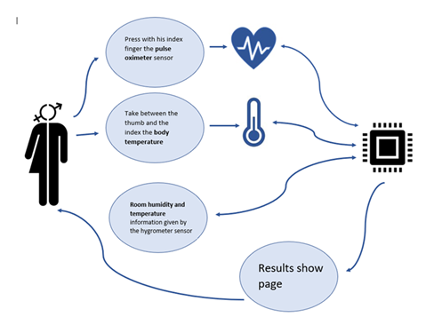
Our solution
The divice must therefore be composed of three sensors, each with a different and specific task:
·Pulse Oximeter Sensor, used to monitor heart rate and oxygenation;
·Temperature sensor, is used to monitor the patient's body temperature;
·Temperature and humidity sensor, is used to monitor the temperature and humidity of the room where the patient is, as these conditions could bring significant changes in the parameters previously described.
The device will input all the above parameters and then bring them back to a single web page, by entering the IP address.

Slide 6
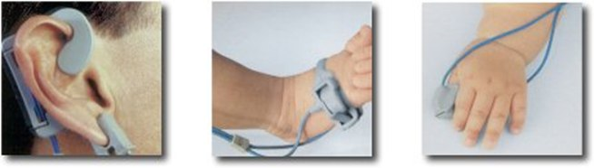
State of the art
The first non-invasive oximeters were the ear oximeters around 1935, but it had too many problems:
Inability todifferentiate light absorbion due to arterial blood from the venous blood and tissues.
High cost of instrumentation
Nowadays, there are small oximeters, based in laser oximetry, that measure the oxygen saturation on the extremities of human body, as finger.
The oximeter has jumped to the forefront of the news because it helps to discover a severe complication, such as pneumonia.
There exists some that also measure body temperature and, in exceptional cases, it can contains also room thermometer.

Slide 7
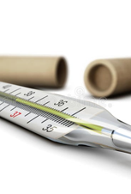
State of the art
There exists different kinds of thermometer.
The first one was 30 cm long and taking a patient's temperature could take up to half an hour.
These days thermometers have many important quality, as:
Compactness
Speed of measurement
Accurancy
The most used in these time are the infrared thermometer, which doesn't need to be touched and takes only few seconds to measure the temperature.

Slide 8
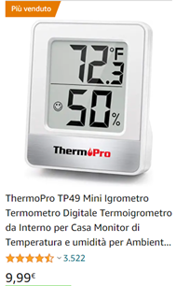
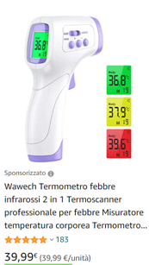
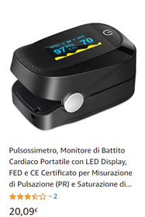
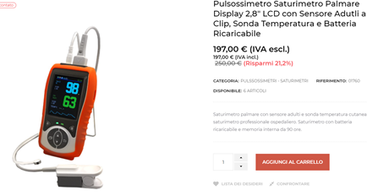
Market Study
 | Min Price | Max Price
Pulse oximeter | 20€ | 200€
Thermometer | 3€ | 1000€
Hygrometer thermometer | 2€ | 300€

Slide 9
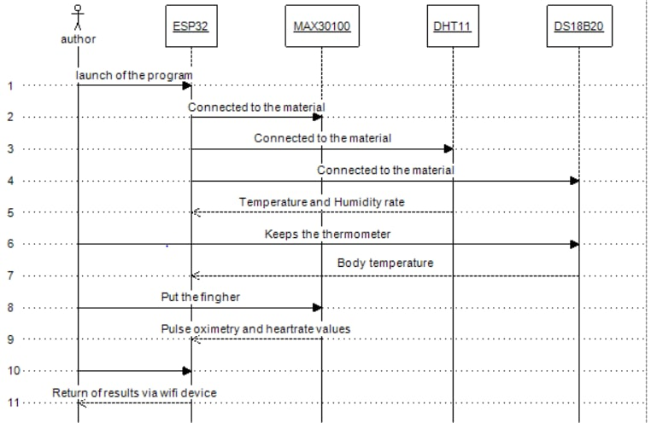
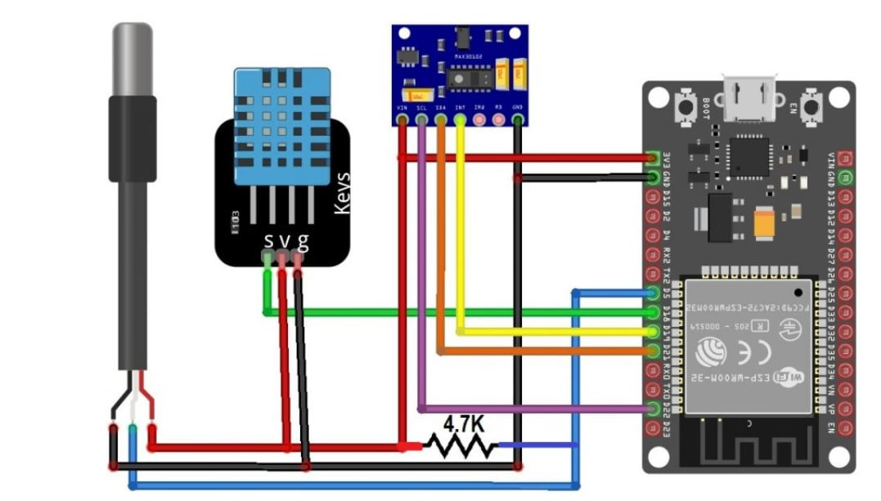
Implementation

Slide 10

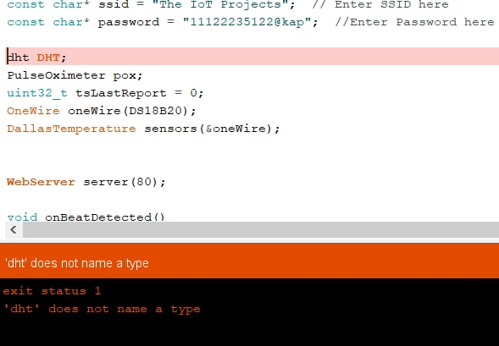
Code
Link of the project code: https://how2electronics.com/iot-based-patient-health-monitoring-esp32-web-server/
During the implementation we encountered problems with this code in the DTH11 component part.

Slide 11

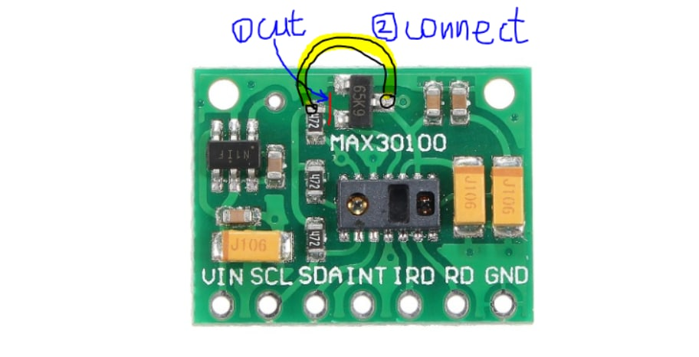
Problem
Another problem encountered concerns the MAX30100: there is a design problem.
The SCL and SDA pins are pulled-up via the 4.7k ohm resistors to 1.8V! This means it won’t work well with microcontrollers with higher logic levels.
A possible solution can be to cut the path in the place of the red cross and make a jumper as shown by the yellow line.

Slide 12
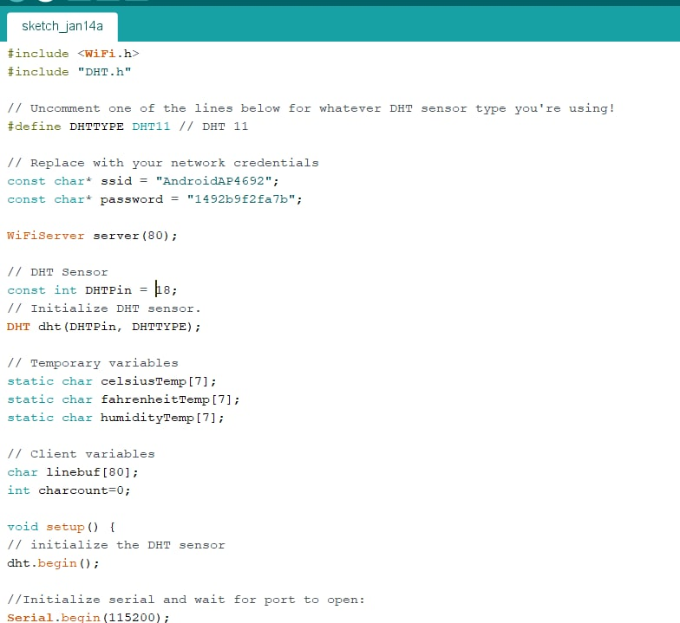
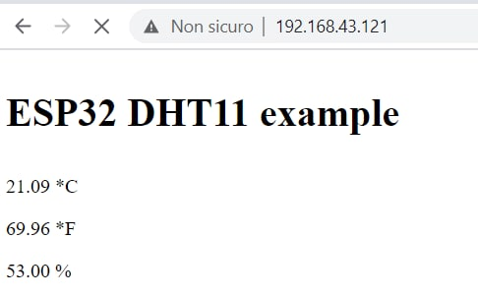
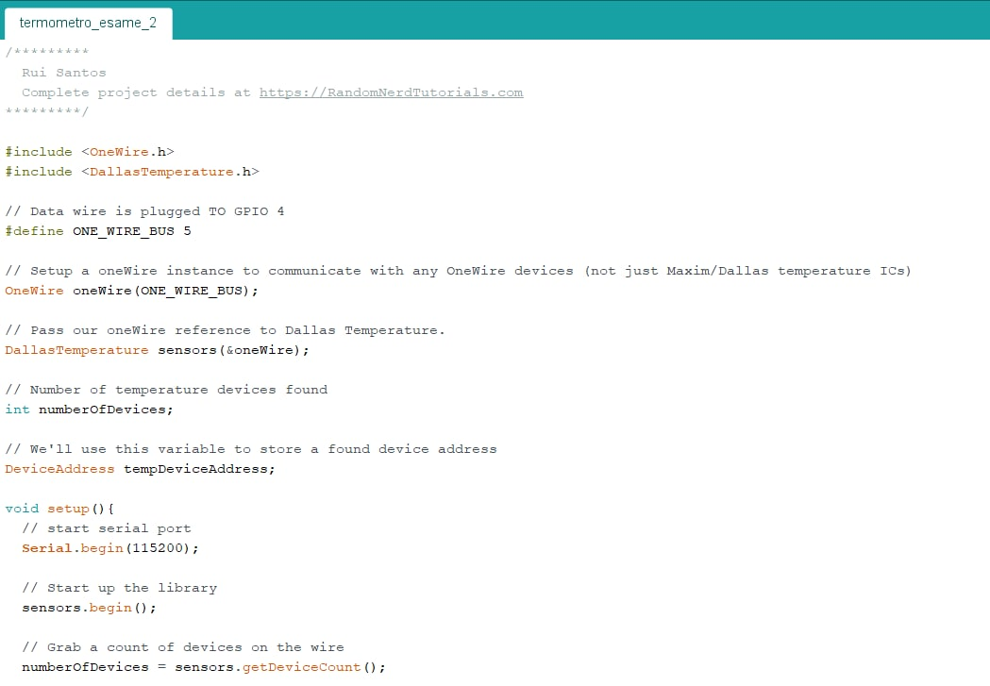
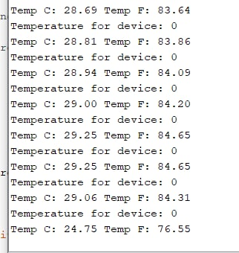
Conclusion
Following the problems encountered, we opted for the construction of multiple devices instead of just one.
Despite several attempts and the modification made, we have not yet been able to solve the problem with the MAX30100.
However, we are convinced that this project, if completed, can be of great help in various situations of health problems.

Slide 13

Merci à vous! Grazie per l'attenzione!

